Slide 1
Study of Student’s ‎ ‎ ‎ Interests in Various ‎ Data-Science Areas.
Presented By-
Pratik Mukund Dokhe
UID: FSRB0422
Date: 11-08-2021

Slide 2
01
Introduction
02
Project Goals
Contents
03
System Requirements
04
Implementation

Slide 3
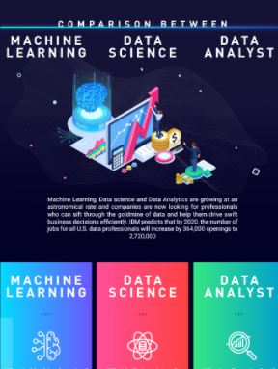
Introduction
What is Data Science?
Data science is the field of study that combines domain expertise, programming skills, and knowledge of mathematics and statistics to extract meaningful insights from data.

Slide 4
Problem
What percent respondents interest in various Data Science areas ?

Slide 5
Solution
Data Visualization

Slide 6
Project Goals
In this project I analyzed the interest of students in various Data Science fields, I am using different-different Data Visualization techniques for it.

Slide 7
System Requirements
Tools Required:
Windos / Mac OS Laptop
Python Programming Language
Jupyter Notebook
Python Libraries Required:
Pandas
Numpy
Matplotlib

Slide 8
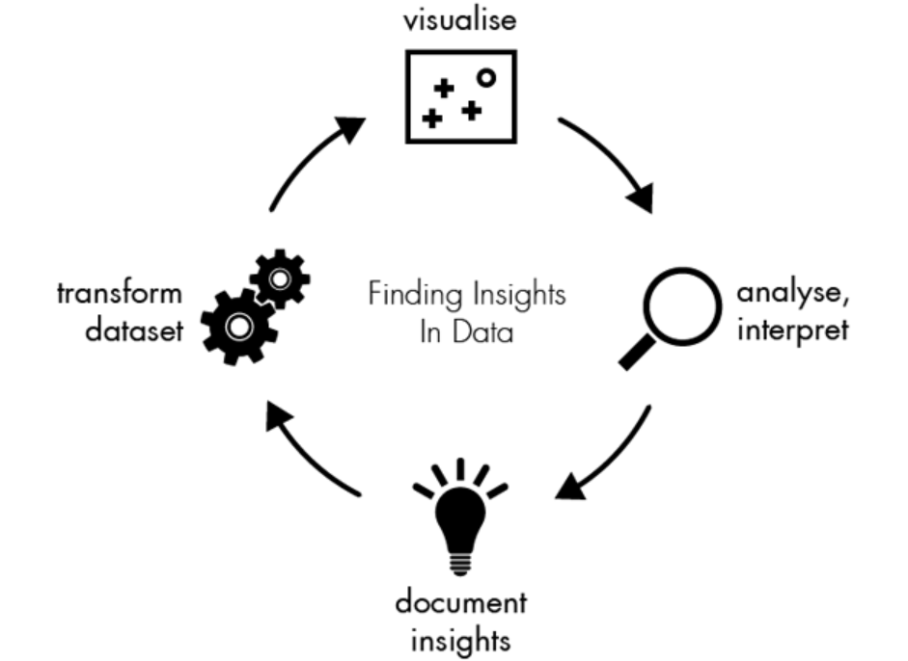
Implementation

Slide 9
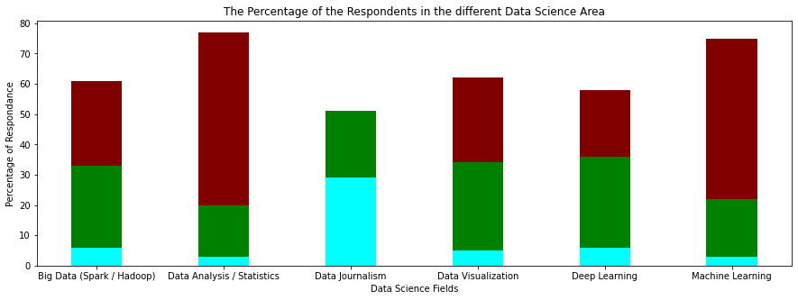

Stacked Bar Chart

Slide 10
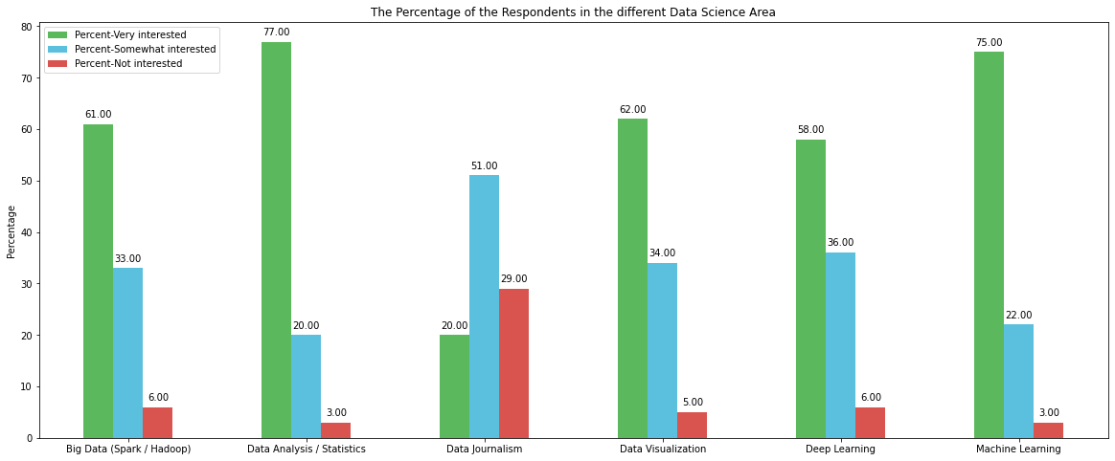
Grouped Bar Chart

Slide 11
Conclusions
Data Analysis / Statistics , Big Data (Spark / Hadoop) & Data Visualization would be one of the most successful fields of Data Science.
Most students are interested in Data Analysis and Statistics fields.
Students are least interested in Data Journalism.

Slide 12
Any Questions ?
Thanks!

